Slide 1
Scenario Brief
Notes:
# Scenario Brief — Content Guide
**Source:** `../../scenario/index.md`
**Audience:** CPT operators who will use this scenario as shared target, terrain, and adversary.
**Duration:** ~45 minutes (single scenario-brief block)
**References:**
- `../../scenario/index.md`
- `../../scenario/overview/background.md`
- `../../scenario/overview/varensk.md`
- `../../scenario/overview/lunovia.md`
- `../../scenario/maps/network-diagram.png`
## Instructor resources and pre-class
- Classroom projector and screen
- Whiteboard and markers (two-state sketch for the opening; capture targeting answers on Slide 8)
- Instructor copies of `../../scenario/index.md`, `../../scenario/overview/background.md`, `../../scenario/overview/varensk.md`, and `../../scenario/overview/lunovia.md`
- Project `../../scenario/maps/network-diagram.png` full-screen on Slide 10
## Student resources
- Student copies of the scenario overview pages listed above
- Course network diagram at `../../scenario/maps/network-diagram.png`
- No additional student kit for this lecture
## Dual opening
### Option 1 (Interactive / Whiteboard / Kinesthetic)
- **Say:** "Before we get into the scenario itself — why fictional? Two reasons. First, classification: a fictional scenario keeps us out of problems during training. Second, common ground: every student, every block, every lab will share this world."
- **Do:** Sketch two neighboring states on the board (large authoritarian state, smaller democratic state, border between them). No real-world place names. Leave the sketch up.
- **Ask (Q):** Who has taken a course that used a real-world actor as the scenario and hit a classification wall mid-lab?
- **Expected Response (A):** Facilitation only. Hands are the point. Do not collect a scored answer.
### Option 2 (Digital Slide / Virtual / Slide Deck)
- **Say:** "Before we get into the scenario itself — why fictional? Two reasons. First, classification: a fictional scenario keeps us out of problems during training. Second, common ground: every student, every block, every lab will share this world. When I say 'Varensk,' you will know what I mean for the rest of the course."
- **Show:** The regional map graphic (two unnamed states; no real-world place names).
- **Do:** Keep the classification-wall check as a verbal show of hands if a whiteboard is not available.
- **Ask (Q):** Who has taken a course that used a real-world actor as the scenario and hit a classification wall mid-lab?
- **Expected Response (A):** Facilitation only. Hands are the point.
---

Slide 2
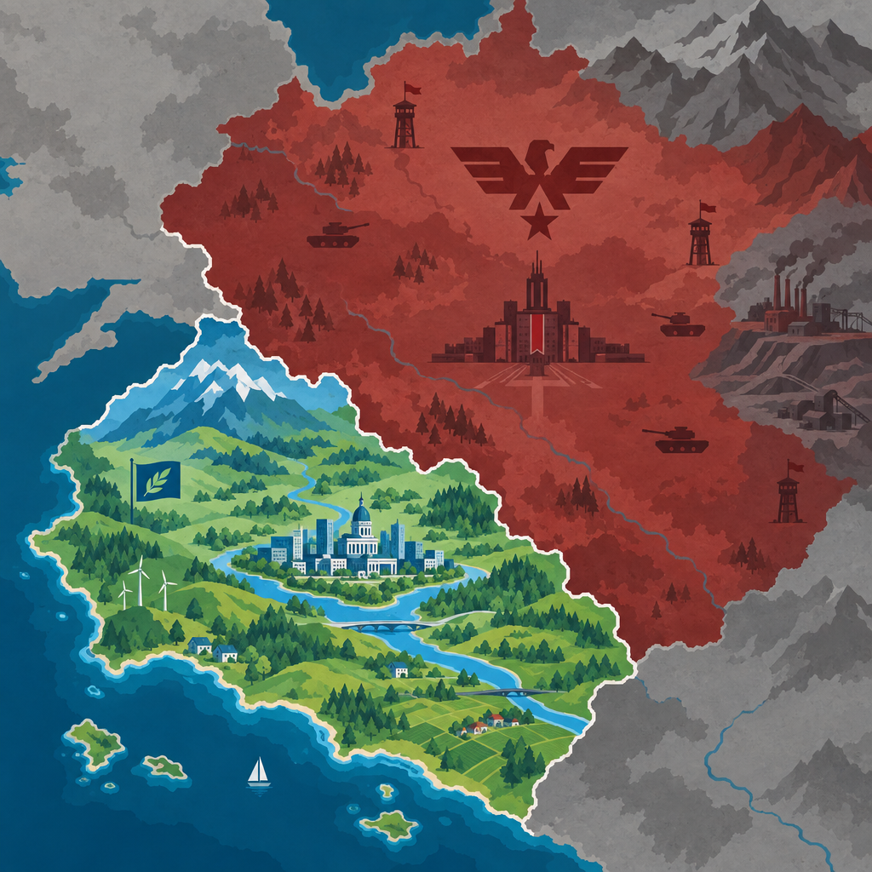
Why We Use a Fictional Scenario
A single, persistent, fictional setting for the whole course
Lets us operate freely without classification or attribution issues
Gives every block a common target, terrain, and adversary
Both sides are deliberate caricatures of real-world archetypes — recognizable without being real
Notes:
Say:
"Before we get into the scenario itself — why fictional? Two reasons. First, classification: a fictional scenario keeps us out of problems during training. Second, common ground: every student, every block, every lab will share this world. When I say 'Varensk,' you will know what I mean for the rest of the course."
Show:
The regional map graphic.
Do:
Take a show of hands. The hands are the point.
Image Prompt:
A stylized regional map graphic — two unnamed states in contrast (a large authoritarian state in muted reds/greys to the north-east; a smaller democratic state in blues/greens to the south-west), with a border line between them. No real-world place names. Clean, illustrative, suitable as a chapter opener.
Ask (Q):
Who has taken a course that used a real-world actor as the scenario and hit a classification wall mid-lab?
Expected Response (A):
Facilitation only. Hands, not a scored answer.

Slide 3
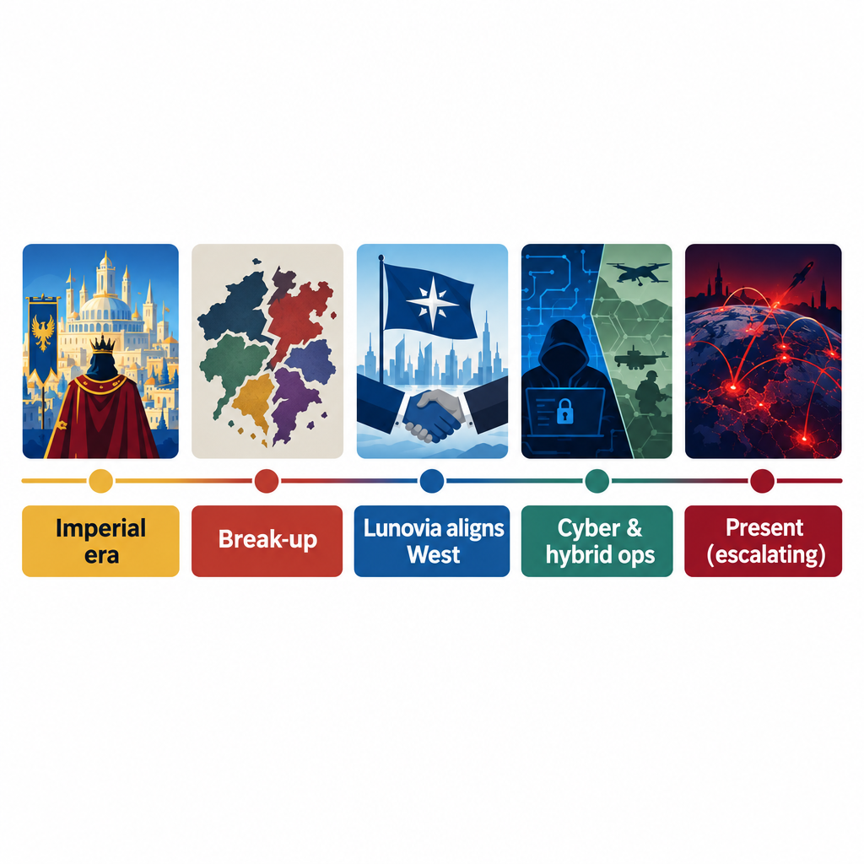
The Conflict in Two Minutes
Two neighboring states; long shared history
Post-imperial break-up: Lunovia pivoted West; Varensk sees that as betrayal
Lunovia accuses Varensk of cyberattacks, disinformation, and separatist support
Past 5 years: increasing military exercises near the border, major cyber operations against Lunovian energy and telecom
International observers: open conflict possible within 3-5 years
Notes:
Say:
"Here is the backstory in a paragraph. Two neighboring states, long shared history. When the old empire broke up, Lunovia went West. Varensk treats that as betrayal. Over the past five years, the border has heated up and Varensk has run cyber and hybrid operations against Lunovia's critical infrastructure. International observers expect open conflict in 3 to 5 years."
Show:
The timeline graphic.
Do:
Let the room call out parallels, then steer back to the scenario names.
Image Prompt:
A simple timeline graphic spanning "Imperial era" → "Break-up" → "Lunovia aligns West" → "Cyber & hybrid ops" → "Present (escalating)". Five tiles on a horizontal line.
Ask (Q):
What real-world parallels do you hear in this backstory?
Expected Response (A):
Facilitation only. Acknowledge parallels, then steer back: "We operate in Varensk vs. Lunovia for the rest of the course."

Slide 4
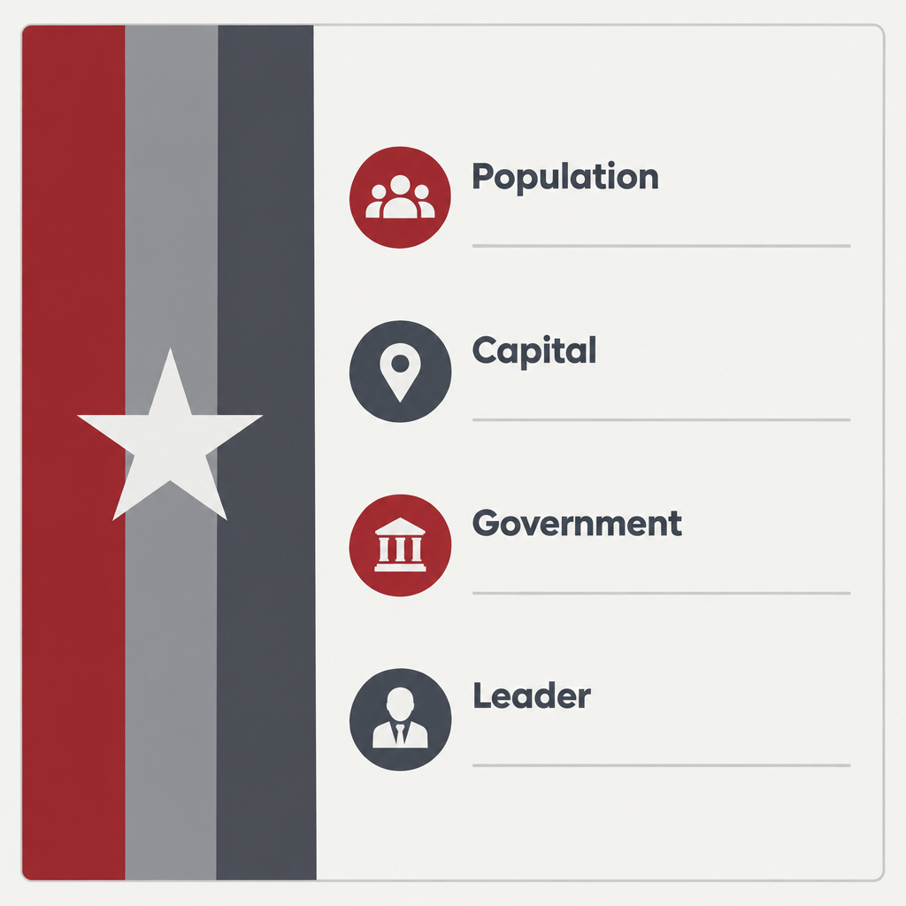
Varensk — Core Identity
~90 million population; one-party presidential republic
Capital: Karsograd
Authoritarian, centralized state with a nationalist ideology — "Varensker Revivalism"
President Viktor Surnov — in power 17 years
Economy: natural gas, rare earths, heavy manufacturing
Foreign policy: regional hegemony; cyber as a primary tool of influence
Notes:
Say:
"Varensk is the big one. Ninety million people, centralized authoritarian government, a nationalist ideology called Varensker Revivalism. The president has been in power 17 years. Economy runs on gas, rare earths, and heavy industry. Their foreign policy is regional dominance and they treat cyber as a primary lever."
Show:
The country-profile card.
Do:
Let the room answer — it seeds the cyber-apparatus discussion two slides from now.
Image Prompt:
A country-profile card graphic. Left side: a stylized flag bar in muted reds and greys. Right side: a list of fact-sheet labels ("Population", "Capital", "Government", "Leader") — labels only, no values — for the lecturer to overlay. Do not put real text in the card so the visual is reusable.
Ask (Q):
If you were in their intelligence service, what would your job priorities be?
Expected Response (A):
Facilitation only. Steer toward influence, espionage, and infrastructure pressure. Do not require a unit name yet.

Slide 5
Varensk — Geography and Strategic Posture
Terrain: northern tundra, central plains (Iron Steppe), eastern coastal marshlands
Key features:
  Iron Steppe — armored maneuver terrain
  Voryn Mountains — natural southern barrier
  Karsenic Coast — naval bases and cyber-intelligence hubs
Strategic posture:
  Pursues regional dominance
  Large, well-funded cyber command integrated with intelligence services
  Uses cyber for espionage, political pressure, and infrastructure disruption
  Runs information operations to shape narratives in neighboring states
Notes:
Say:
"Physical geography matters even in a cyber course. The Karsenic Coast hosts their naval bases *and* their cyber-intelligence hubs. That co-location is realistic — in the real world, signals and cyber infrastructure cluster near the sea and near the core."
Show:
The bullet list; linger on Karsenic Coast.
Do:
Tie back: "When we plan against Varensk in later blocks, 'location' on your SALUTE is going to point here."
Image Prompt:
No image required for this slide — the Varensk profile in Slide 3 is sufficient; this slide is content-heavy and benefits from room to read.
Ask (Q):
When we plan against Varensk later, where does SALUTE location point on this map?
Expected Response (A):
Steer toward the Karsenic Coast (naval bases and cyber-intelligence hubs).

Slide 6
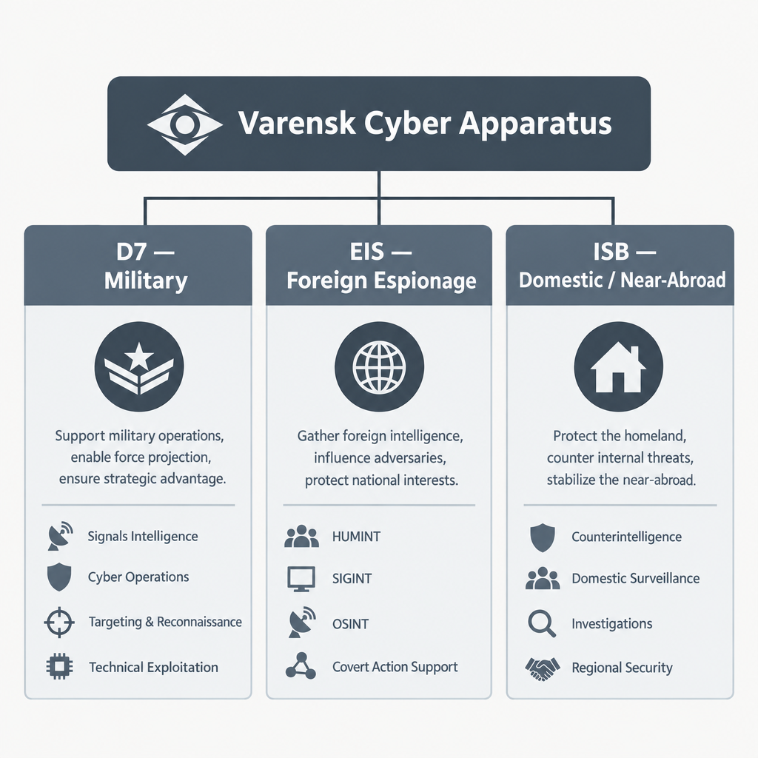
Varensk Cyber Apparatus — Three Directorates
Directorate 7 (D7) — Military Cyber Operations
  Destructive, battlefield-support, supply-chain, ICS/SCADA
External Intelligence Service (EIS) — Foreign Espionage
  Stealthy, long-dwell, cloud-identity focused
Internal Security Bureau (ISB) — Domestic and Near-Abroad
  Hack-and-leak, political interference, rapid-deploy malware
Notes:
Say:
"Varensk's cyber apparatus has three directorates. D7 is the military cyber arm — the destructive one. EIS is foreign espionage — the stealthy one. ISB is domestic and near-abroad — the loud, politically-driven one. When we plan against a specific actor in this course, you will trace them back to one of these three."
Show:
The three-column diagram.
Do:
Preview: the next slide breaks each directorate into specific units.
Image Prompt:
A three-column organizational diagram. Top bar: "Varensk Cyber Apparatus". Three columns below: "D7 — Military", "EIS — Foreign Espionage", "ISB — Domestic / Near-Abroad". Each column styled identically. Clean, neutral color palette.
Ask (Q):
Which directorate is destructive, which is stealthy, and which is politically loud?
Expected Response (A):
D7 destructive; EIS stealthy; ISB politically loud / hack-and-leak.

Slide 7
Varensk Cyber Units and Real-World Analogues
D7 — Military
  Unit 7440 Black Forge — ICS/SCADA disruption (Havoc C2)
  Unit 2213 Iron Wolf — destructive malware, supply-chain (Empire C2)
  Unit 9931 Storm Pike — battlefield cyber/EW (Empire C2)
EIS — Foreign Espionage
  Group Seraph-3 — stealthy cloud persistence (Cozy Bear analogue; Mythic C2)
  Group Lattice-9 — diplomatic / NGO espionage (Mythic C2)
ISB — Domestic / Near-Abroad
  Unit 18 Amber Tide — hack-and-leak, political ops (Gamaredon analogue; Metasploit Framework)
  Unit 47 Sable Net — border-region cyber operations (Metasploit Framework)
Notes:
Say:
"Here is the unit-level detail. Pay attention to the C2 framework assignments — they are intentional and consistent through the course labs. Also note the real-world analogues in parentheses: *Seraph-3* plays the Cozy Bear role; *Amber Tide* plays the Gamaredon role. When we do the Gamaredon walk-through in Block 2 and the labs use *Amber Tide* instead — that is the reason."
Show:
The unit list; point specifically to Unit 18 *Amber Tide* and note its Gamaredon role.
Do:
Tell students to dog-ear this slide. They will return to it every time the course names a Varensk unit.
Image Prompt:
No image required for this slide.
Ask (Q):
Which Varensk unit plays the Gamaredon role in this course, and which plays Cozy Bear?
Expected Response (A):
*Amber Tide* (Unit 18) = Gamaredon; *Seraph-3* = Cozy Bear.

Slide 8
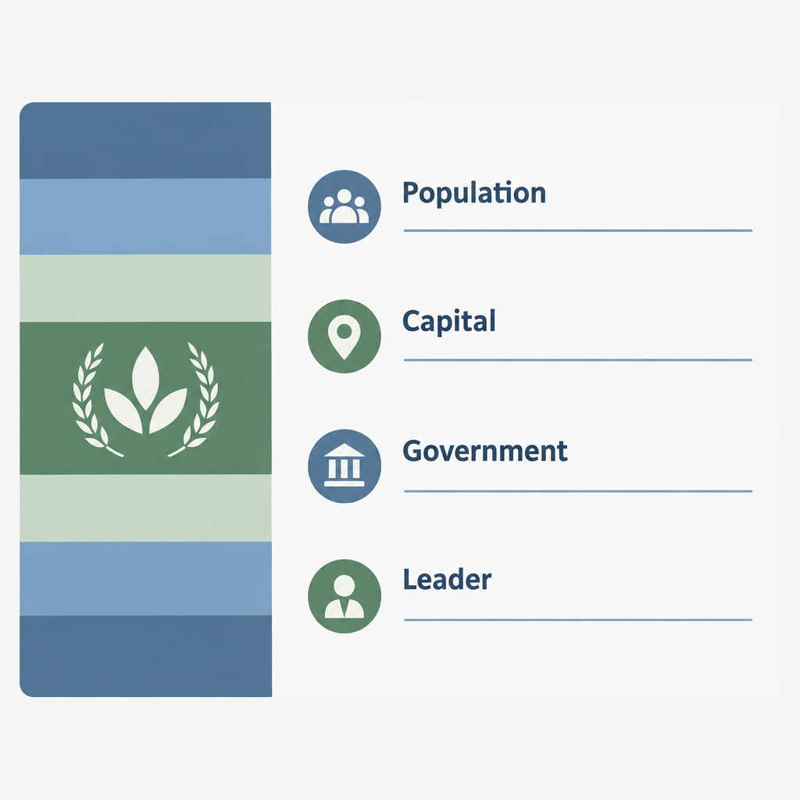
Lunovia — Core Identity
~32 million population; parliamentary democracy
Capital: Velystok
Prime Minister: Alina Veskova
Younger, more urban, more globally connected than Varensk
Diversified economy; rapidly expanding digital infrastructure
Foreign policy: align with Western democracies, build cyber resilience, pursue digital sovereignty
Notes:
Say:
"Lunovia is the smaller, democratic state. Thirty-two million people, parliamentary republic, younger and more urban than Varensk. Their economy is diversified and *digital*. Their foreign policy is Western alignment, cyber resilience, digital sovereignty. In short — they look like the state we usually find ourselves defending."
Show:
The country-profile card.
Do:
Draw the parallel explicitly. Get a nod of understanding from the room.
Image Prompt:
A country-profile card matching Slide 3's layout, not a travel brochure. Left: a stylized flag bar in muted blues and greens. Right: fact-sheet labels only ("Population", "Capital", "Government", "Leader") with blank value lines. No climate, attractions, tourism, or "country name" placeholder map.
Ask (Q):
When we are the blue team, who are we in this scenario? When we plan DCO-RA out of blue-space, who are we?
Expected Response (A):
Blue team = Lunovia. DCO-RA out of blue-space = a Lunovian unit.

Slide 9
Lunovia — Geography and Strategic Posture
Terrain: rolling plains, fertile agricultural heartland, dense northern forests
Key features:
  Lunovian Corridor — flat, open — vulnerable to mechanized invasion
  Vel River — powers hydro; runs through the capital
  Western Highlands — natural defensive terrain
Strategic posture:
  Heavy investment in defensive cyber, especially critical infrastructure
  Partnerships with foreign cybersecurity firms and allied intelligence sharing
  Small but professional military; strong territorial defense doctrine
  Heavy cloud reliance — efficient, but a disruption vector
Notes:
Say:
"Lunovia's strategic posture is exactly where a lot of real-world partner nations sit — heavy investment in defensive cyber, lots of allied partnerships, strong territorial defense, and a cloud-heavy digital government. That cloud reliance is efficient, but it is also an attack surface we will revisit."
Show:
The bullets; linger on the last sub-bullet (cloud reliance).
Do:
Capture two or three answers on the board.
Image Prompt:
No image required for this slide.
Ask (Q):
Name one thing you would target first if you were Varensk and you wanted to rattle Lunovia without triggering a kinetic response.
Expected Response (A):
Facilitation only. Cloud, energy, telecom, or hydro on the Vel River are on-scenario. Do not grade a single correct target.

Slide 10

Lunovia Cyber Defense Structure
National Cyber Defense Agency (NCDA)
  Protects government networks; coordinates incident response; runs national CERT
Digital Infrastructure Protection Corps (DIPC)
  Guards energy, telecom, and transportation sectors; works with private industry
  Includes a Cyber Auxiliary Reserve — volunteer experts activated in crises
Foreign Cyber Partnerships
  Intelligence sharing with allied democracies
  Joint exercises and red-team exchanges
Notes:
Say:
"Lunovia's defensive cyber structure has three pillars. NCDA runs the CERT and defends government networks. DIPC guards critical infrastructure sectors and includes a volunteer cyber auxiliary. And their foreign partnerships provide intelligence sharing and joint exercises. If you are playing blue, you are probably in NCDA or DIPC."
Show:
The three-pillar diagram.
Do:
Use the answers to set CPT assignment lanes (NCDA or DIPC).
Image Prompt:
A three-pillar organizational diagram for Lunovia's defense, styled as a mirror of Slide 5's Varensk diagram. Pillars labeled "NCDA — National Cyber Defense Agency", "DIPC — Digital Infrastructure Protection Corps", and "Foreign Partnerships". Do not invent other expansions (not coastal defense, not intelligence planning command).
Ask (Q):
Which Lunovian pillar would you most likely be assigned to as CPT operators?
Expected Response (A):
Facilitation only. NCDA or DIPC are the expected lanes from the Say script.

Slide 11
The Network Diagram
Course network diagram lives at ../../scenario/maps/network-diagram.png
This is the terrain for planning, recon, on-target work, and automated response
Trace subnets, zones, and key hosts in this hour
Varensk units oppose; Lunovia defends; you are the counter-strike operator
Notes:
Say:
"Last slide. This is the network. Study it. Planning uses this terrain. Recon scans it. On-target work lives inside it. Agentic workflows automate against it. Varensk units are the opposition; Lunovia is the defender; you are the counter-strike operator."
Show:
Project `../../scenario/maps/network-diagram.png` full-screen. Walk subnets, zones, and key hosts.
Do:
Give the room **5 minutes** of quiet time to trace the diagram. Collect the questions — they seed later planning discussion.
Image Prompt:
No image required for this slide.
Ask (Q):
After tracing the diagram, write down three questions about this network.
Why is the scenario fictional?
Name Varensk's three cyber directorates and one unit you will see again.
Which operational-environment elements on the Lunovian side will impact later planning?
Expected Response (A):
Facilitation only. Collect questions; no target answers.
## Lesson summary
The course uses one fictional setting so every block shares a common target, terrain, and adversary without classification problems.
**Varensk** is the authoritarian adversary: three cyber directorates (D7, EIS, ISB) and named units with C2 assignments and real-world analogues (*Amber Tide* / Gamaredon; *Seraph-3* / Cozy Bear).
**Lunovia** is the defender: NCDA, DIPC, foreign partnerships, and heavy cloud reliance. Blue team = Lunovia; DCO-RA out of blue-space = a Lunovian unit.
The course network diagram is the terrain for planning, tradecraft, on-target, and agentic work.
## Questions and check on learning
Classification / attribution safety, and a common target-terrain-adversary for every block.
D7, EIS, ISB. Accept any listed unit; *Amber Tide* and *Seraph-3* are the analogues called out on Slide 6.
Steer toward cloud reliance, NCDA/DIPC structure, Lunovian Corridor / Vel River / Western Highlands, and the course network diagram as terrain.

Slide 12
Questions?

